Slide 1

Web Development 1
© Hugh McCabe & Matt Smith 2008-2014
Lecture 6d
Navbar vertical – styling nav list of links

Slide 2
list of links should be marked-up as a LIST of links If main nav links on page, then place inside ‘nav’
While we could create nav bars with links as blocks
Meaningful, semantic, markup (and current practice in the web development community), requires us to use an unordered list of links when creating navbars
So we need to learn to style lists of links for navigation:
<nav>
<ul>
<li><a href="index.html">home</a></li>
<li><a href="products.html">products</a></li>
<li><a href="about.html">about</a></li>
<li><a href="contact.html">sitemap</a></li>
</ul>
</nav>
HMTL

Slide 3
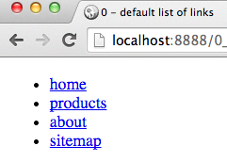
Default styling list of links
<nav>
<ul>
<li><a href="index.html">home</a></li>
<li><a href="products.html">products</a></li>
<li><a href="about.html">about</a></li>
<li><a href="contact.html">sitemap</a></li>
</ul>
</nav>
HMTL

Slide 4
How make list of links look like nice vertical navigation bar?
1 – 2 – 3 …

Slide 5
3 steps to styling vertical navbars
Remove nav list spacing and bullet points
nav ul
Make nav ‘a’ elements display as blocks
nav a
Add desired styling rules for:
nav a (unvisited/visited state)
nav a:hover (mouse hover over state)
nav a.current_page (highlight current page link)

Slide 6
Step 1 remove bullets and spacing from nav list

Slide 7
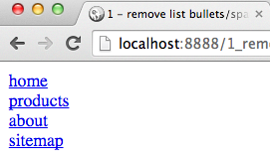
Step 1 Remove bullets and spacing from nav list
nav ul {
list-style-type: none;
margin: 0;
padding: 0;
}
CSS

Slide 8
Step 2 Make nav ‘a’ elements display as blocks

Slide 9
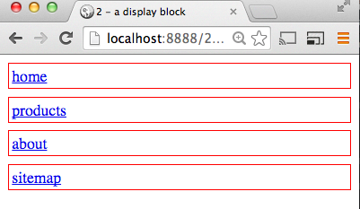
Step 2 Make nav ‘a’ elements display as blocks
nav a {
display: block;
border: 0.1rem solid red;
padding: 0.2rem;
margin-bottom: 0.5rem;
}
CSS

Slide 10
Step 3a Add desired styling rules for: a

Slide 11
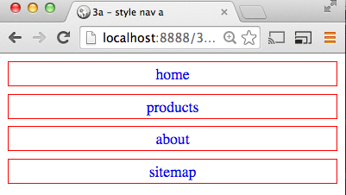
Step 3a Add desired styling rules for: a
nav a {
display: block;
...
text-decoration: none;
text-align: center;
}
CSS

Slide 12
Step 3b Add desired styling rules for a:hover

Slide 13
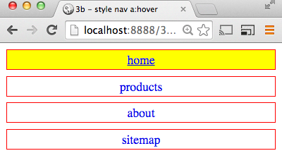

Step 3b Add desired styling rules for: a:hover
nav a:hover {
text-decoration: underline;
background-color: yellow;
}
CSS

Slide 14
Step 3c Add desired styling rules for: a.current_page

Slide 15
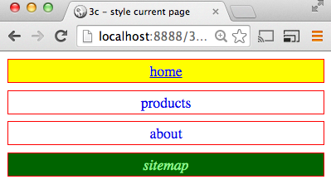
Step 3c: style a.current_page
Assume current page is sitemap
<nav>
<ul>
<li><a href="index.html">home</a></li>
<li><a href="products.html">products</a></li>
<li><a href="about.html">about</a></li>
<li><a href="contact.html"
class="current_page">sitemap</a></li>
</ul>
</nav>
HTML

Slide 16
Step 3c: style a.current_page
Assume current page is sitemap
nav a.current_page {
color: lightgreen;
background-color: darkgreen;
font-style: italic;
}
CSS

Slide 17
nav ul {
list-style-type: none;
margin: 0;
padding: 0;
}
nav a {
display: block;
border: 0.1rem solid red;
padding: 0.2rem;
margin-bottom: 0.5rem;
text-decoration: none;
text-align: center;
}
nav a:hover {
text-decoration: underline;
background-color: yellow;
}
nav a.current_page {
color: lightgreen;
background-color: darkgreen;
font-style: italic;
}
CSS rules for all 3 steps
CSS

Slide 18
Summary and Conclusions

Slide 19
3 steps to styling vertical navbars
Remove nav list spacing and bullet points
nav ul
Make nav ‘a’ elements display as blocks
nav a
Add desired styling rules for:
nav a (unvisited/visited state)
nav a:hover (mouse hover over state)
nav a.current_page (highlight current page link)

